Slide 1
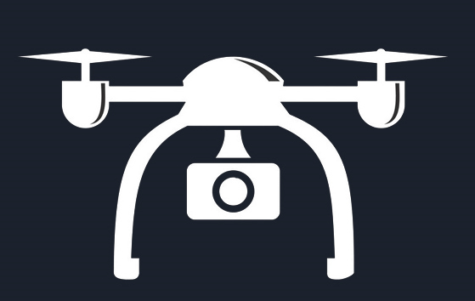


Drone
Bootcamp
Aeromodelling Club
IITK

Slide 2
Week 1 | Introduction,Avionics,Types of Aircrafts,Terminologies used,IMU,Mission planner installation,Quiz 1
Week 2 | Drone Kinematics:transformations,Rotations,Euler angles,Angular Velocity Controlling Basics:Stability,Magnetometer,Barometer,Accelerometer,Gyro,Different parts of drone Avionics discussion
Week 3 | Drone dynamics: Forces in flight,Degrees of Freedom,Study the pitch,roll,yaw motion Controlling Advanced: Types of controller,Connection and power distribution with diagram,ESC and their functioning
Week 4 | SITL and basic waypoint follower in mission planner,Integration with ardupilot,Pixhawk flight controller,Midterm evaluation
Timeline
Week 5 | Matlab and Simulink On Ramp Course Ubuntu Installation,Catkin tools and workspace,Introduction to Gazebo
Week 6 | Introduction to ROS and ROS terminal commands,Rosbag,Creating Nodes and packages through simple listener and talker roscpp ,end term evaluation

Slide 3
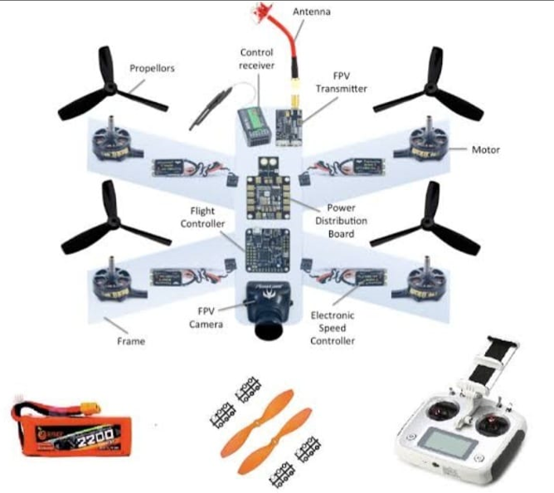
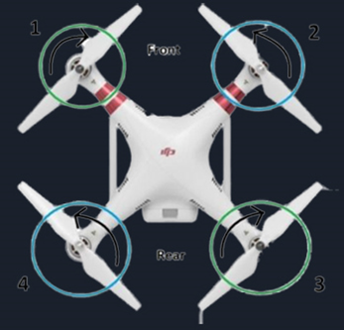
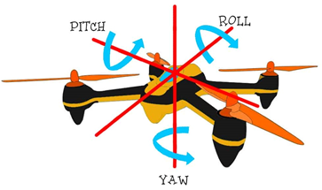
COMPONENTS OF A DRONE
QUADCOPTER
Basic avionics of drone:-
➢BLDC motor
➢Electronic Speed Controller
➢Receiver
➢Transmitter
➢Battery
➢IMU
➢Flight controller
➢Radio telemetry
CONTROLLING BASICS IN DRONE
IMU
ACCELEROMETER
MAGNETOMETER
BAROMETER
GYROSCOPE

Slide 4
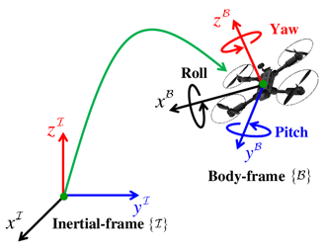
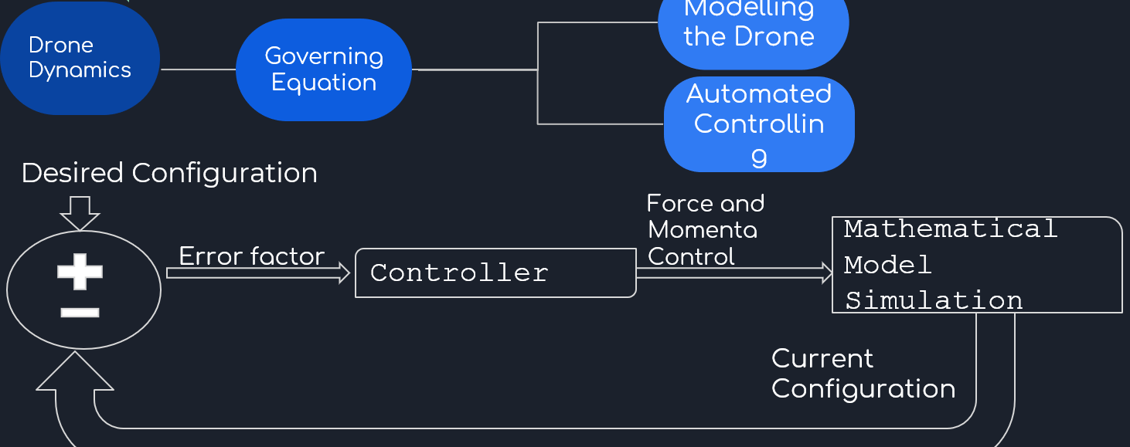
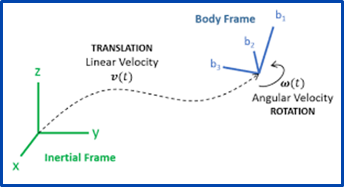
Dynamic quantities-
p = Mv
L= r x Mv + I⍵
where
●p - linear momentum
●L - angular momentum
●M - mass of drone
● v - velocity of COM of drone
● I - moment of inertia of drone
●⍵ - angular velocity
● r - position of drone w.r.t reference point
DRONE KINEMATICS AND DYNAMICS
Any 2 configuration of a drone (rigid body) can be linked by a rotation about an axis. Vector data need to be transformed from body fixed coordinate system of drone to ground coordinate system using some maths !Further, Velocity and acceleration of any point on drone can be calculated (provided some data) using some equations.Hexacopter works similar to a drone in motion principles.
Using three laws of drone dynamics,a drone controls all yaw,pitch,roll,elevation motions

Slide 5
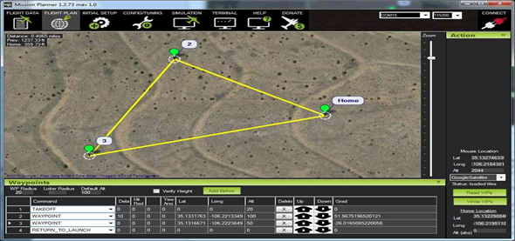
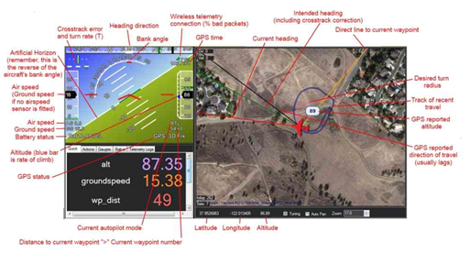
MISSION PLANNER
FLIGHT PLANNING
It is a fully-functioning GUI Ground Control Station(GCS) for multicopters, planes, helicopters & Rovers.
Functions :
❖Planning the flight mission before flight
❖Monitors and receiving flight information in Real time
❖Configure the Autopilot according to our needs
❖Virtual Simulating flights using SITL
❖Configuring the RC Remote
Flight Modes :
●Acro Mode -Maintain altitude level
●Stabilize Mode:Allows manual control of vehicle
●Loiter Mode:Current altitude,orientation and heading direction is maintained.
SITL FEATURE-
Allows to run plane,copter or rover without any hardware.It works on ardupilot .It can be used to plan and execute missions

Slide 6
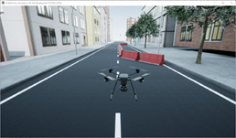
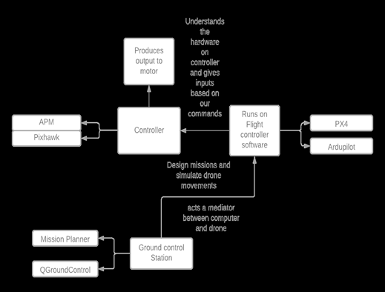

Matlab and Simulink
They help model,control and simulate a drone.
Components of Drone Simulation:
●Drone dynamic Model
●Drone Flight control model
●Sensor Model
●Simulation Environment
●Autonomous Algorithm
Flight control software and their integration with controllers

Slide 7

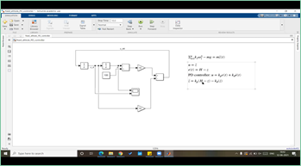

Matlab and Simulink Onramp Course
& Ubuntu Installation
You can get a quick hands-on experience on Matlab and Simulink by doing short onramp courses.
Some links for doing the onramp course:
https://matlabacademy.mathworks.com/
https://www.mathworks.com/learn/tutorials/matlab-onramp.html
We have to install Ubuntu 18 for running Gazebo and ROS
For the installation process, follow this link: https://itsfoss.com/install-ubuntu-dual-boot-mode-windows/
Discord Server link for help:
https://discord.gg/ubuntu

Slide 8

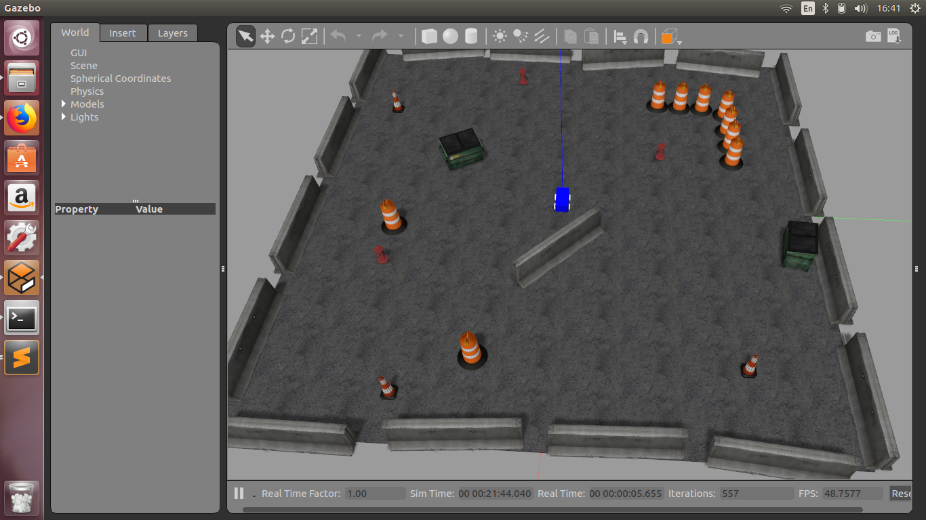
Gazebo : Robot Simulator
Gazebo is a 3D dynamic simulator which offers Physics simulation,with the ability to accurately and efficiently simulate a population of robots in virtual environment.
To put it simply, Gazebo is a simulated environment that obeys the laws of physics where we can test robots.
Reference Link: http://gazebosim.org/tutorials
Husky Simulator

Slide 9
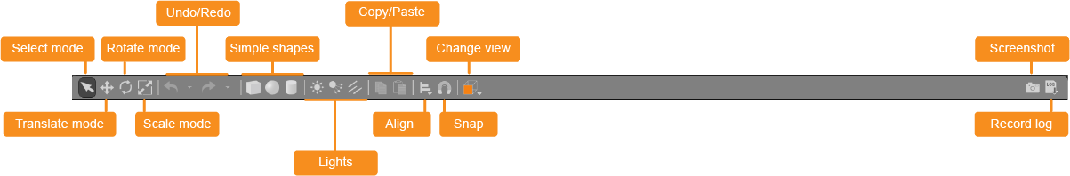
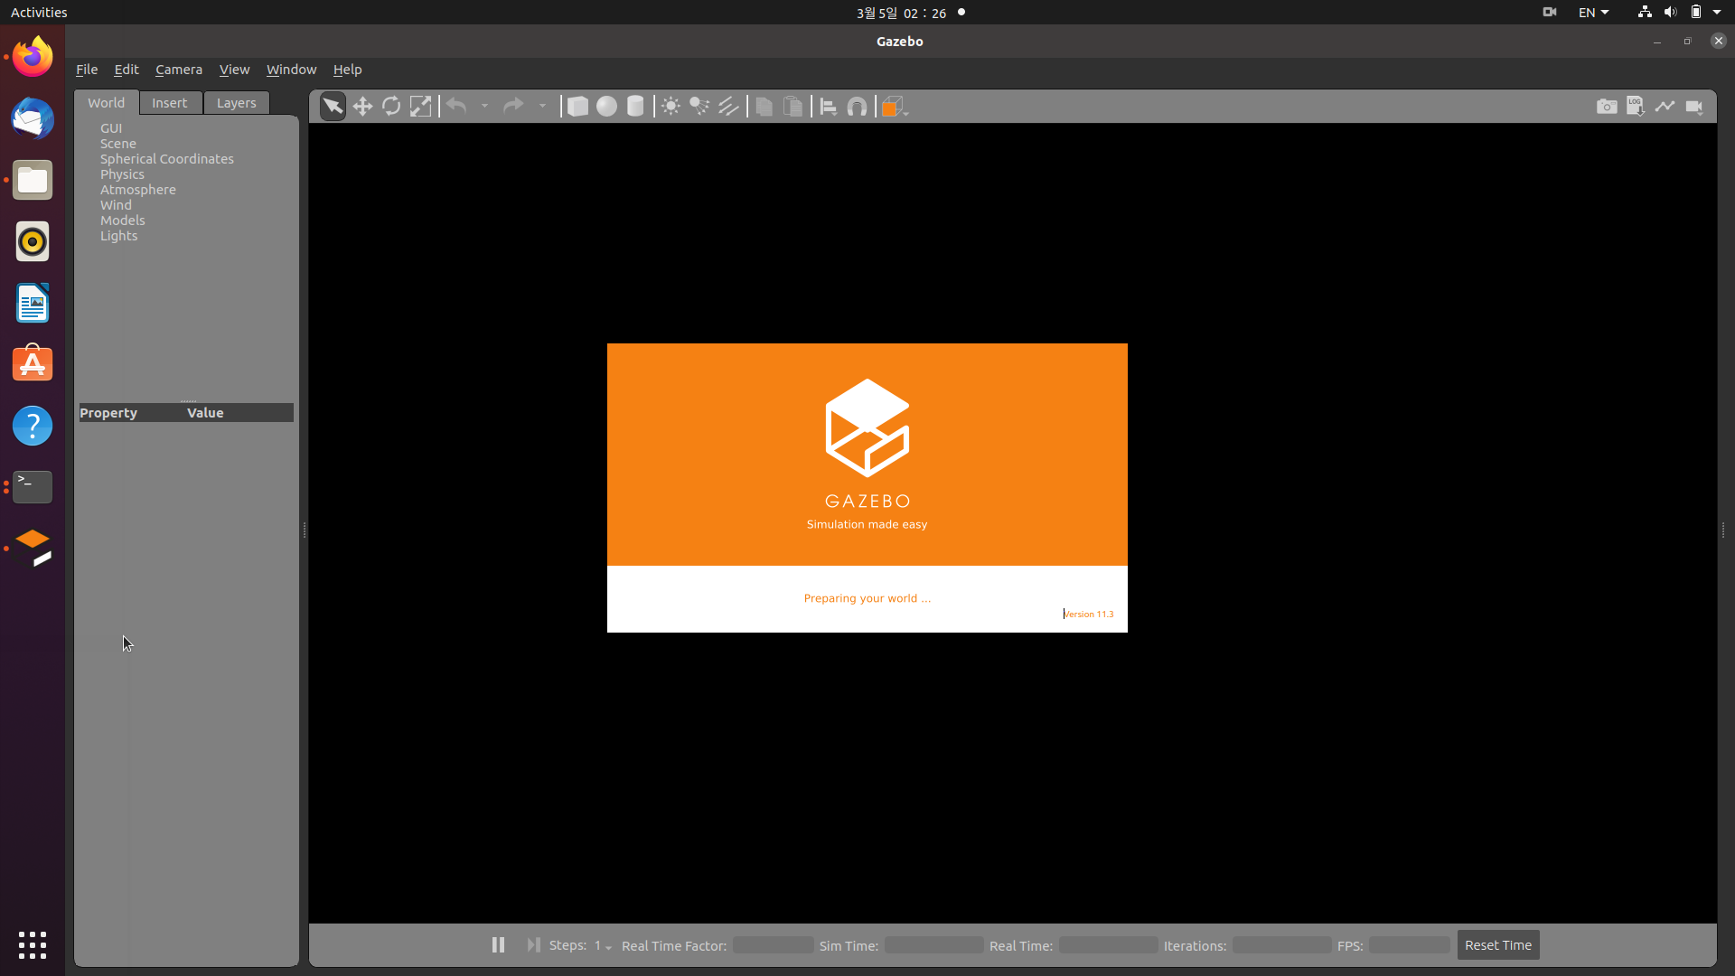
Gazebo : Screen Overview
Select mode: Navigate in the scene
Translate mode: Select models you want to move
Rotate mode: Select models you want to rotate
Scale mode: Select models you want to scale
Undo/Redo: Undo/redo actions in the scene
Simple shapes: Insert simple shapes into the scene
Copy/paste: Copy/paste models in the scene
Change view: View the scene from various angles
Align: Align models to one another

Slide 10
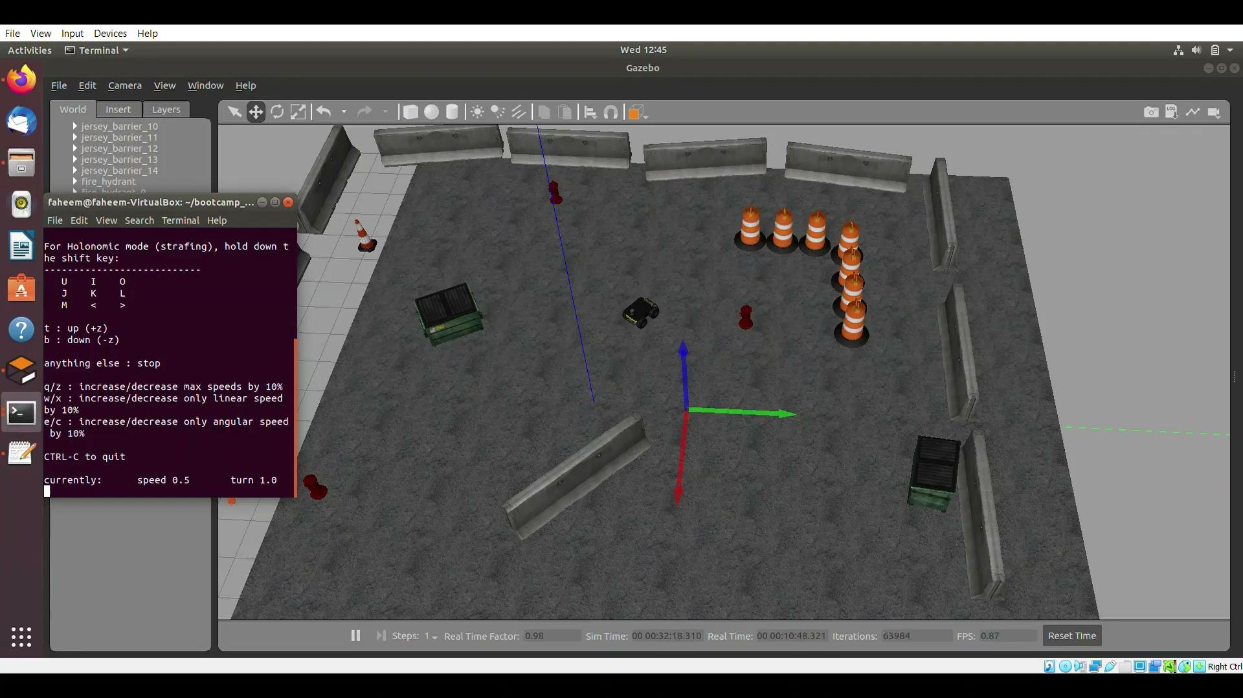
Husky Simulator in Gazebo
.
Husky moving in the virtual world : A part of Assignment under the project

Slide 11
Gazebo : Applications and Benefits
What are the uses of Gazebo? 🤔
B
E
N
E
F I
T
S
Applications
Fly the ArduPilot firmware on a simulated drone(connecting the native APM SITL to Gazebo)
Simulate various sensors and experiment using them to control or influence flight.
Test python-dronekit scripts before going out to the field.
Save time : Rapidly prototypes advanced scripts without having to go out on field.
Save Money: Debugging new openCV scripts on a real drone is not only dangerous, but could be expensive with all the inevitable crashes.
Save a limb : Much easier to use Gazebo 3D simulation to test complex control scripts.

Slide 12

Robot Operating System(ROS)
ROS is an open-source, meta-operating system for your robot. It is a medium of communication between the hardware and software of the robot.
What actually is ROS? 🤯
It is NOT a language.
To put it simply, ROS is just a library in c++ and python containing lots of data types and functions.

Slide 13

R-Robot
O-Operating
S-System
Steps of installation:-
Configure your repositories
Set up sources.list
Set up your keys
Installation
Environment setup
Dependencies for building packages
Installation link:- http://wiki.ros.org/Installation/Ubuntu

Slide 14
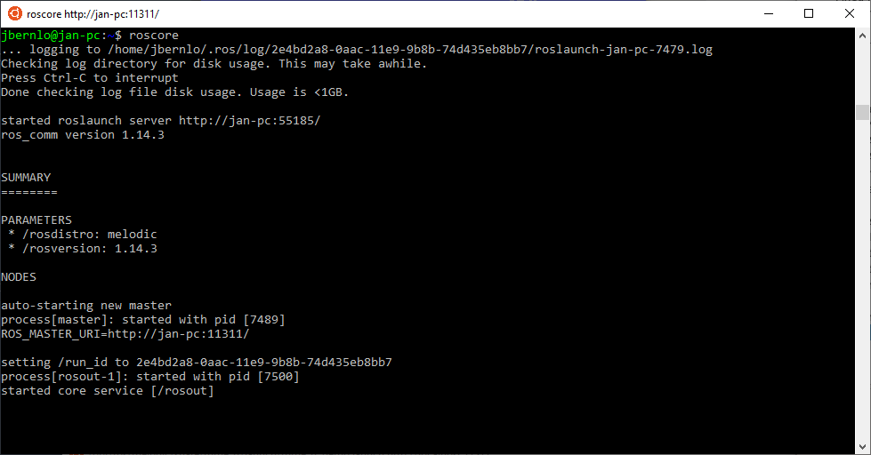
ROS : Advantages
3Save Time : Introduced the concept of packages that allows us to use previously written packages directly.
Integration : Integrated with third party softwares like Gazebo and Rviz.
Standard Architecture to program robots currently.
Messages and Topics : Simplified working with sensors and other hardwares with the use of messages and topics.
ROS is open-source.
Basic ROS window

Slide 15
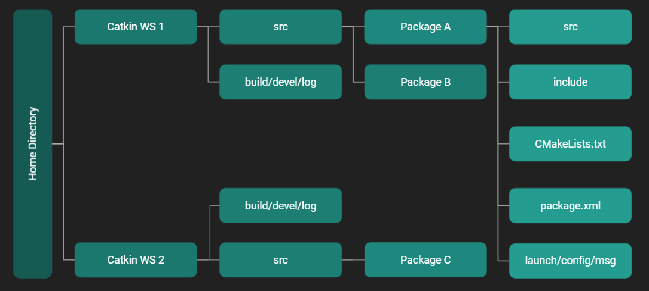
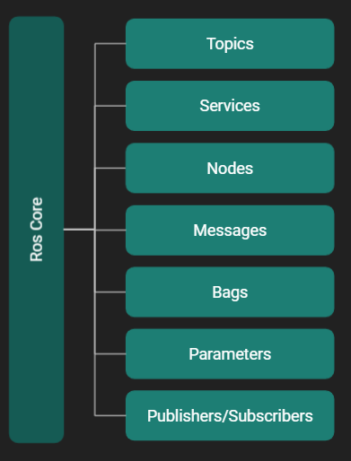
Structure of ROS : Network and File System
Packages : Packages are the main unit for organizing software in ROS.
src : This folder stores the C++ source codes.
include : This folder consists of headers and libraries that we need to use inside the package.
CMakeLists.txt : This files contains the directives to compile the package.
package.xml : This is the package manifest file of this package.
Nodes : Nodes are processes that perform computation.
Topics : The topic is a name that is used to identify the content of the message.
Services : The ROS service is a kind of request/reply interaction between processes.
Bags : Bags are a format for saving and playing back ROS message data.
Messages : Nodes communicate with each other by passing messages.
Publishers/Subscribers : A ROS Node can be a Publisher (Sender) or a Subscriber (Receiver).

Slide 16
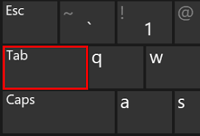
ROS Commands
Remember:
Tab is your pal.
ROS Terminal commands
rosnode | list, info, kill, ping
rostopic | list, info, type, find, echo, pub, hz
rosservice | list, info, type, find, call
rosparam | list, get, set
rosmsg | show
rossrv | show
roscd | used for switching between various ROS package directories
rospack find | gives exact path to a ROS package
rosls | allows you to ls directly in a ROS package
rosed | allows you to edit any file in any ROS package
roscore | starts up ros
rosrun | used to start a node

Slide 17
Rosbags
Used to store message data from topics
We can store a bag and then play it later on any other system
Very used for in-dept analysis in case of any failures.
Commands
To record:
$ rosbag record -o [BAG_NAME] [TOPIC_NAME1] [TOPIC_NAME2] [...]
To play a rosbag:
$ rosbag play {BAG_NAME}.bag – loop
NOTE
This will play the bag on loop till you stop it using Ctrl+C
When you play a bag, no nodes are created,only the messages are published

Slide 18
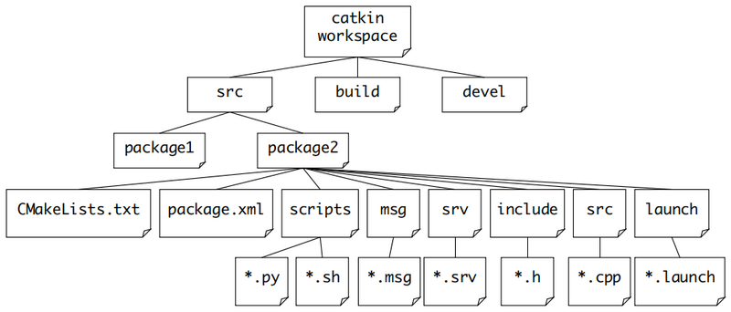
Catkin
Official build system of ROS
Provides workspace for us to work
Uses g++ , python and Cmake
All the ROS packages are cloned in {catkin_ws}/src
Install Catkin using: $ sudo apt-get install ros-melodic-catkin

Slide 19
Overview of Catkin Tools
Built-in Catkin tools:-
build
config
clean
create
init
list
locate
profile
env
Install using:-
$ sudo sh -c 'echo "deb http://packages.ros.org/ros/ubuntu `lsb_release -sc` main" > /etc/apt/sources.list.d/ros-latest.list'
$ wget http://packages.ros.org/ros.key -O - | sudo apt-key add -
$ sudo apt-get update
$ sudo apt-get install python-catkin-tools

Slide 20
Creating and Building Catkin Workspace
STEP 1: Create a folder.
STEP 2: Create a src folder inside it using command: $ mkdir src
STEP 3: Then initialize catkin workspace inside src using command: $ catkin init.
STEP 4: Then build catkin workspace using command : $ catkin build
STEP 5: Then you have to inform the system about changes to your packages. This can be done in two ways:
First- using the command : $ source ~/<folder name>/devel/setup.bash
Second-You can just put the above source command in your .bashrc file.

Slide 21
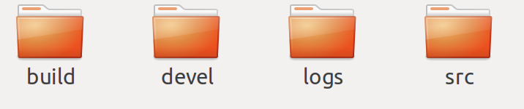
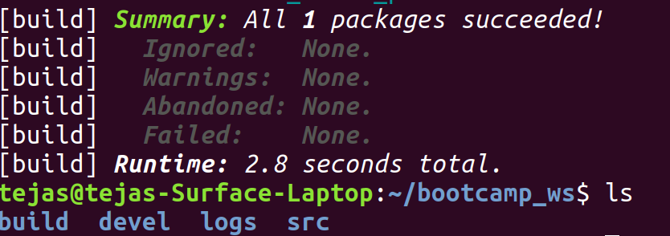
Contain all the packages which we will be using and other supplementary files.
ROS places built files of the package in devel for development/testing
This where CMake is invoked to build the catkin packages.
Note:
We usually don’t edit the files present in the build,devel as they are crucial for building the package using CMake

Slide 22
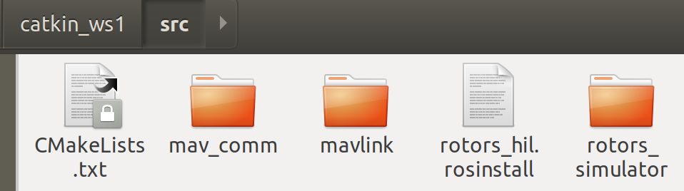
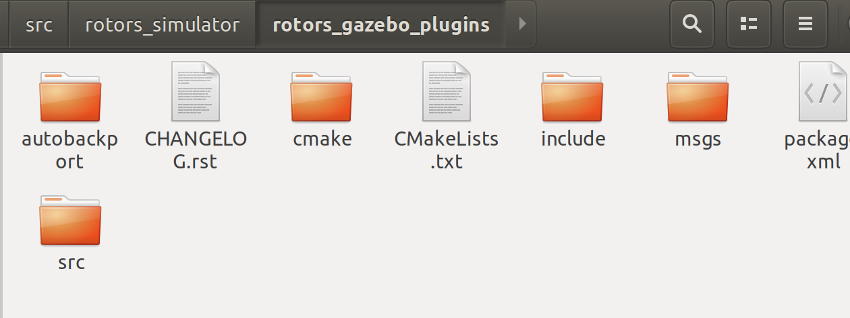
Understanding the src folder in the workspace
Through the RotorS simulator
Collection of Packages present in this workspace
Consists of all the header files that are used during the running of the nodes
It is a data struct and it helps in transmitting information between nodes
Contains all the node executable code files

Slide 23
LAUNCH FILES
Used to launch multiple nodes in a single terminal
Launches roscore by itself too
Writes all the messages in the same terminal
All launch files are in launch folder and end with extension .launch
These are written in XML formal.
CREATING A LAUNCH FILE
Create a launch directory in you package
$cd [package_name] >> $ mkdir launch >>$ cd launch
Create a launch file node.launch and open it.

Slide 24
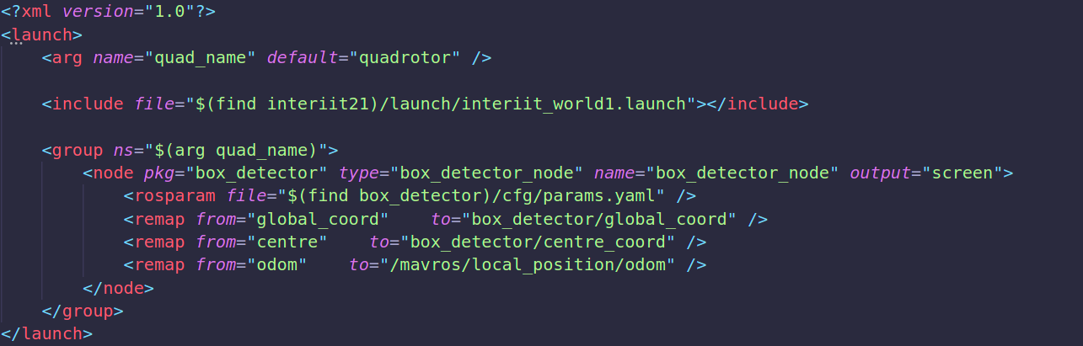
First line: <?xml version="1.0" encoding="UTF-8"?> specifies that file is in XML
Second line: <launch> specifies that file is a launch file
Nodes are added using:
<node pkg="[PACKAGE_NAME]" type="[EXECUTABLE_NAME]“ name="[NODE_NAME]“output="screen"/>
arg is used to define arguments which can be used anywhere in the launch file
include is used to include other launch files!
rosparam is used to include the params file
remap is used to change remap topic names
Last line: </launch> ends the launch tag

Slide 25
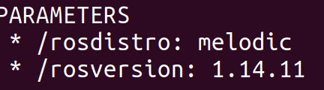
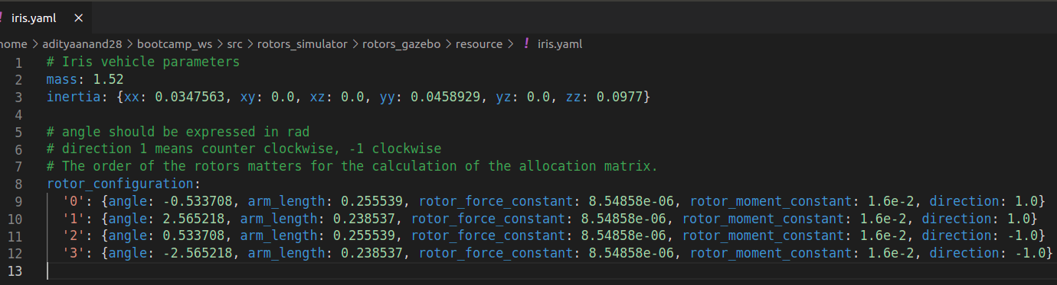
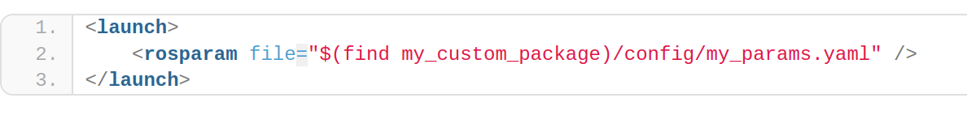
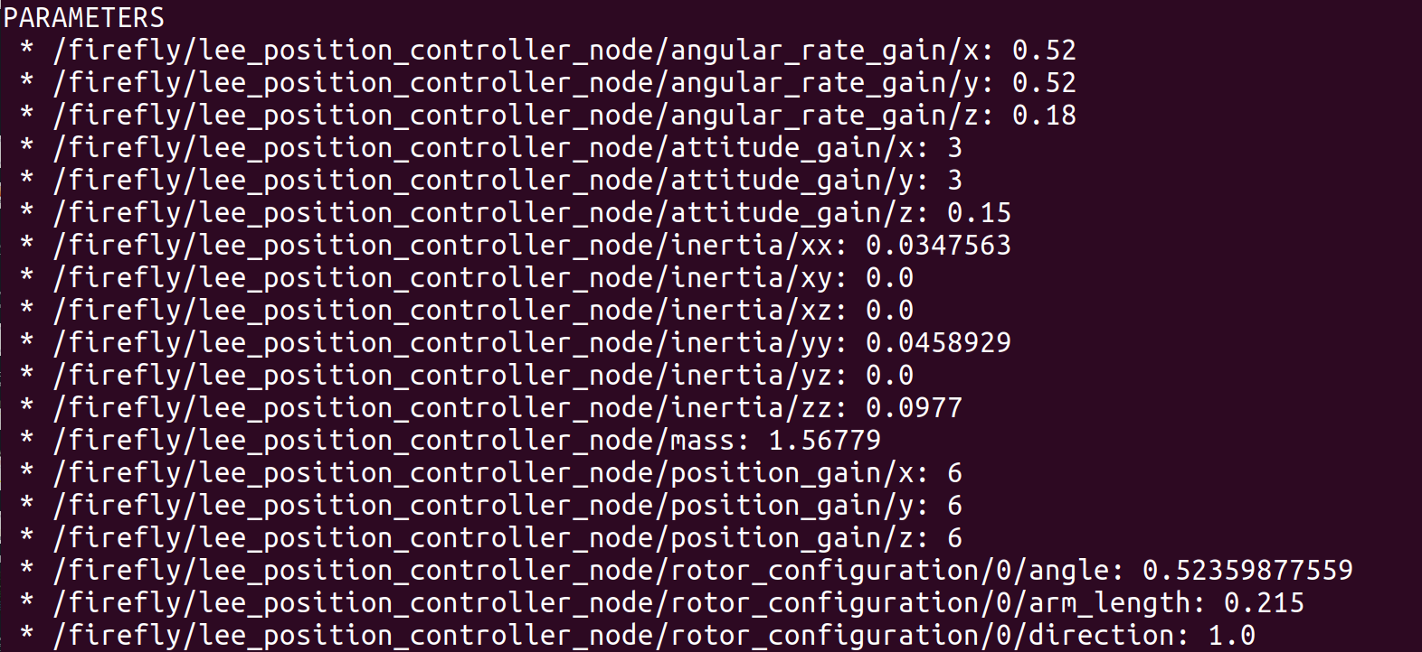
Parameter server file
As you can see in this example it is having YAML format and it has parameters which can be changed and the same changes will be applied to the the nodes using these parameters(usually present in the config folder).
These parameter files can be added to launch files (the Parameters present in the Roscore are also made from param files) this allows easy viewing of the parameters established while running the launch file

Slide 26
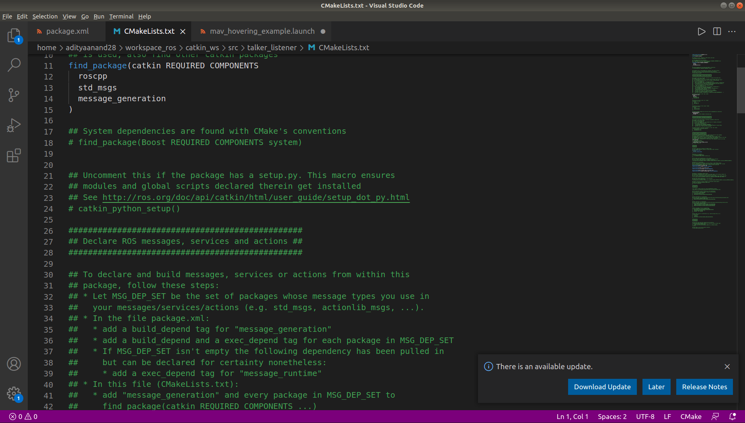
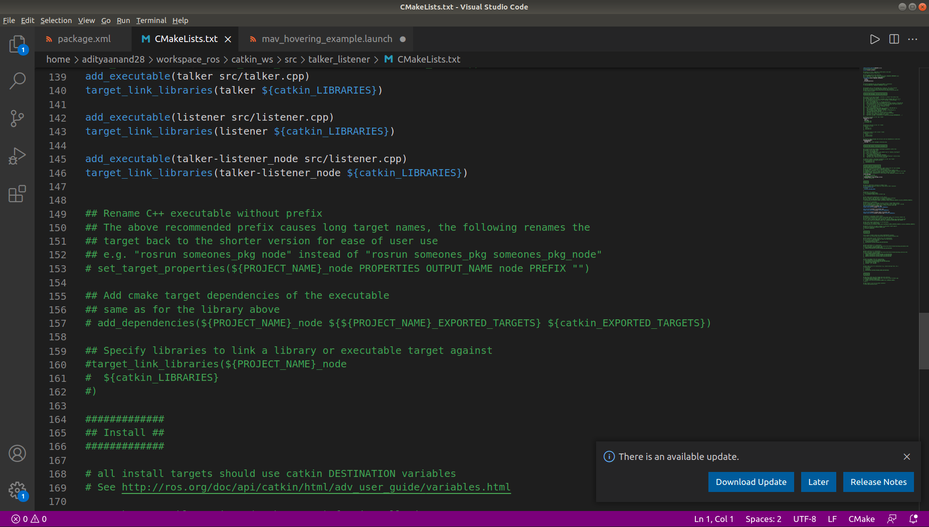
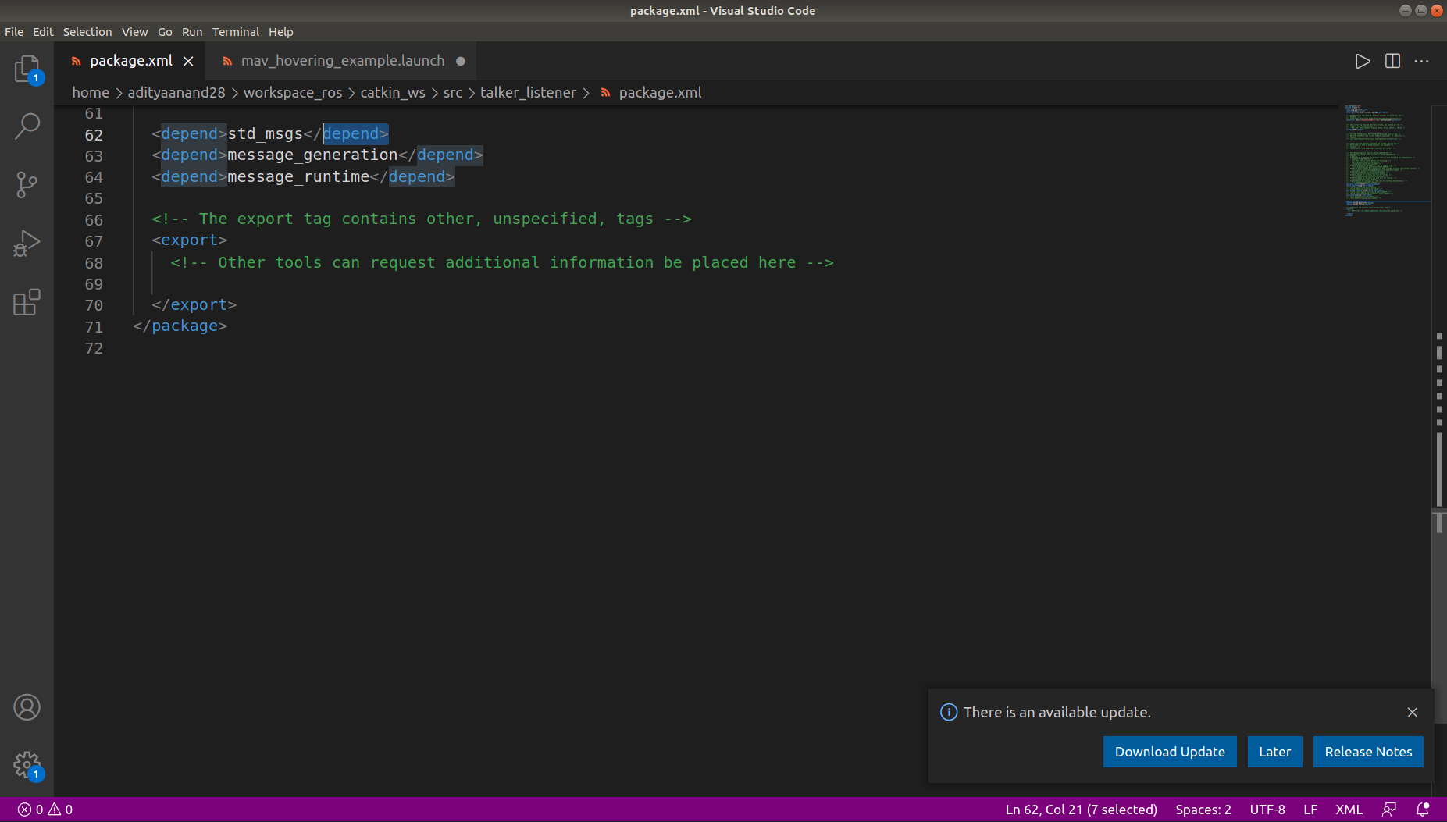
Package XML file
CMakeList txt file
It defines the properties like:
Package name
Version Number
Author
Dependencies (on other packages)
There are various tags, used to add dependencies. One of them is <depend>. This is a build, export and execution dependency.
CMake is a build tool & it given instructions like- libraries location, compiler to use, etc.
Some common dependencies are: rospy, sensor_msgs, nav_msgs, cv_bridge, etc.

Slide 27
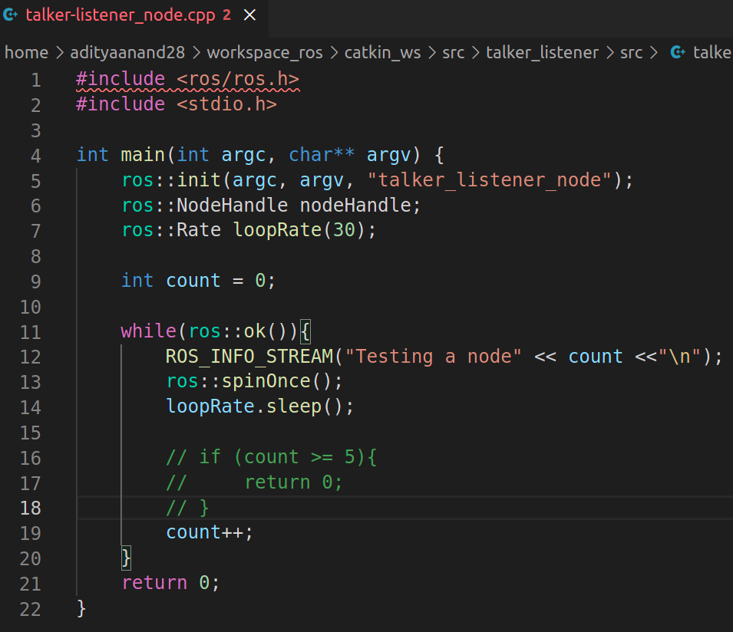
Example Node- Talker Listener
Argument specific rate in Hz
Return false when Ctrl+C is pressed
This prints the value of count, after each iteration.

Slide 28
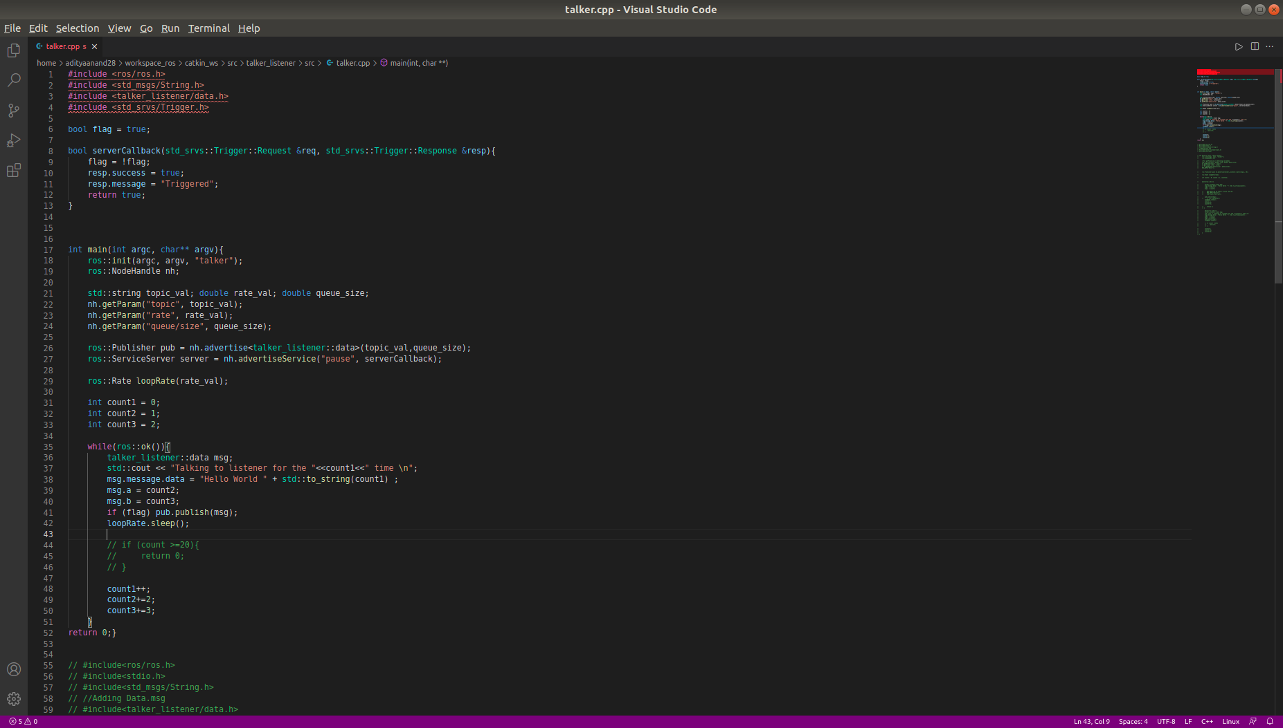
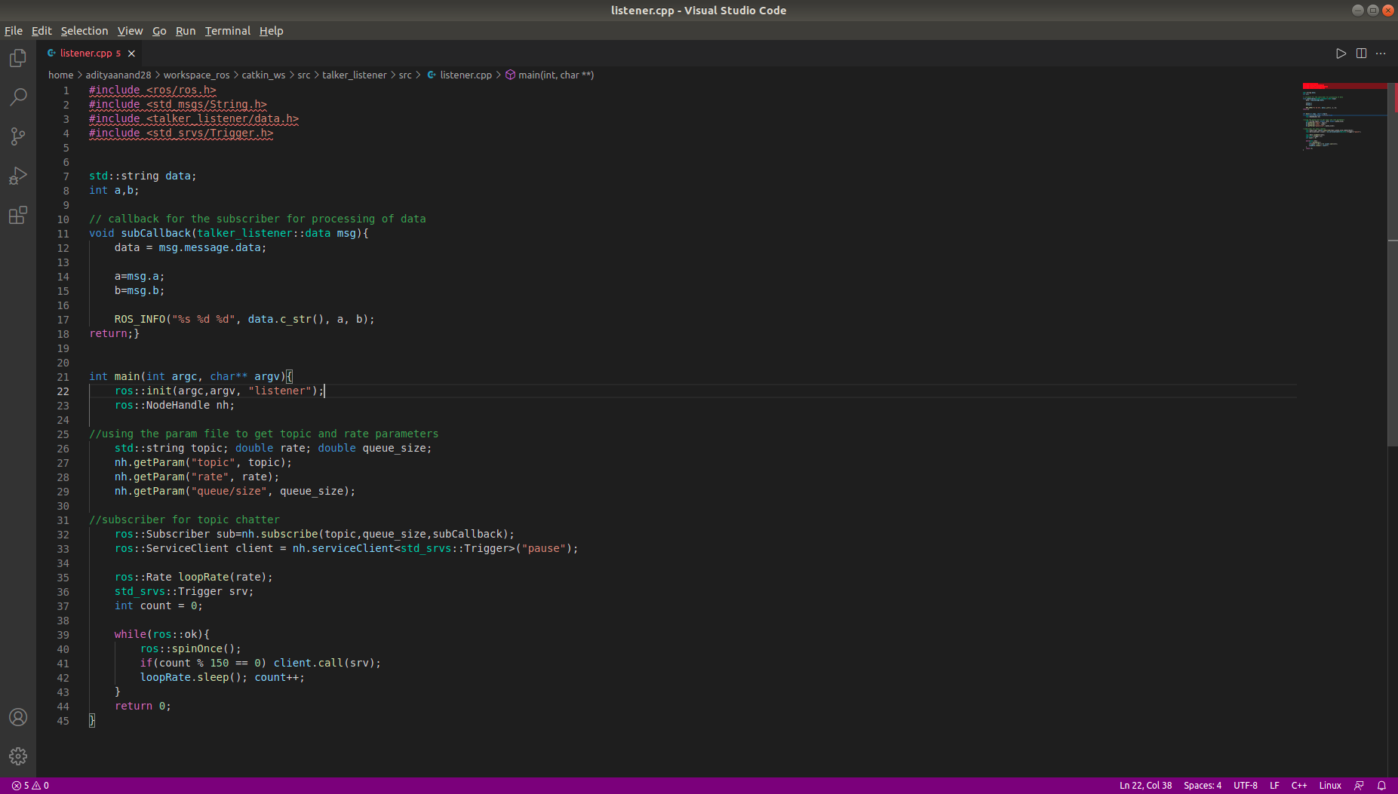
Talker and listener file
This is the code script for listener and talker file respectively.
listener.cpp
To exit after particular value.
talker.cpp

Slide 29
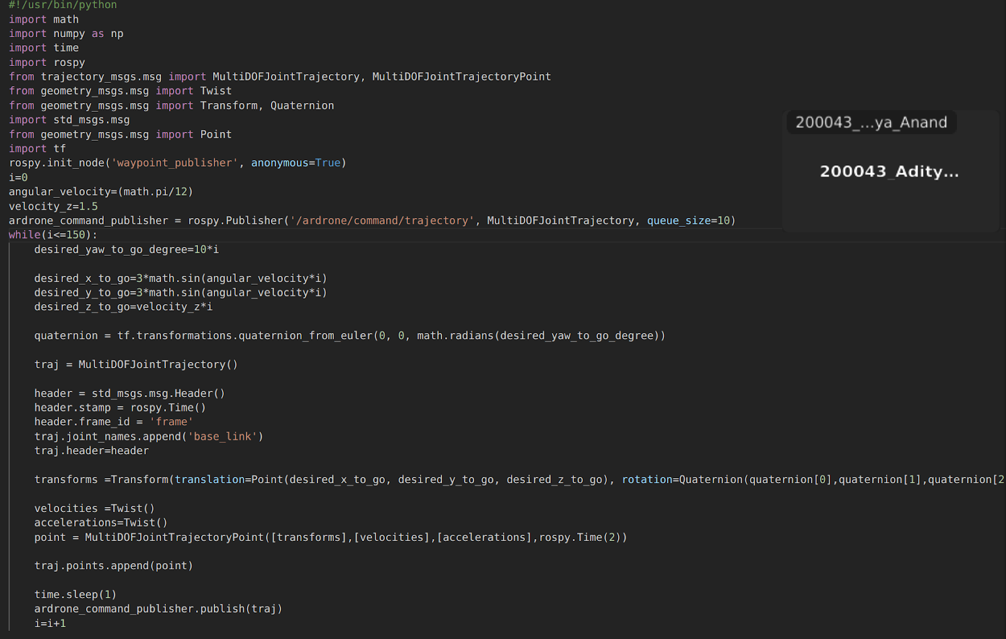
RobotS - UAV gazebo simulator
This is the node file corresponding to the package.
Giving both angular and vertical velocity, we make it to go in helical path.
Angular Velocity
Vertical Velocity
}
Desired Location

Slide 30
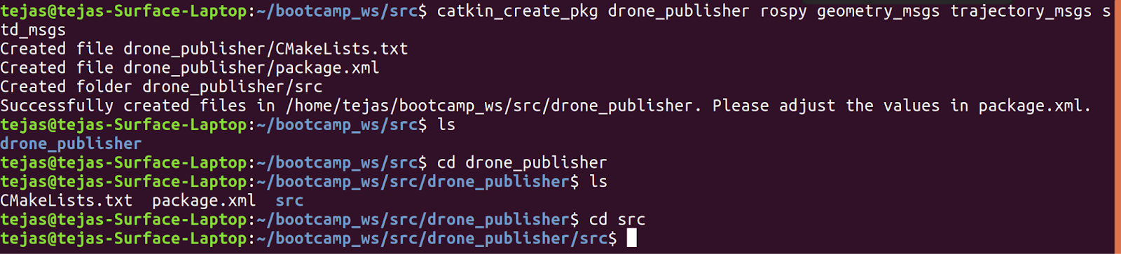
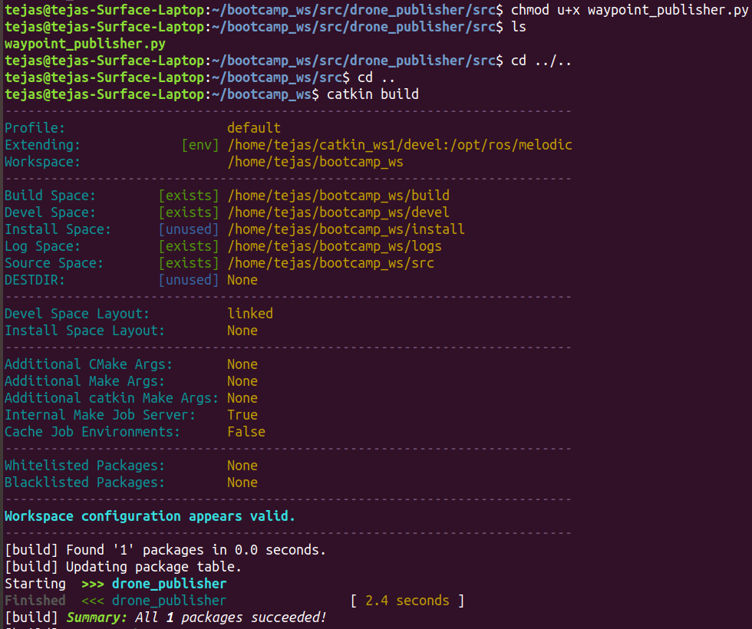
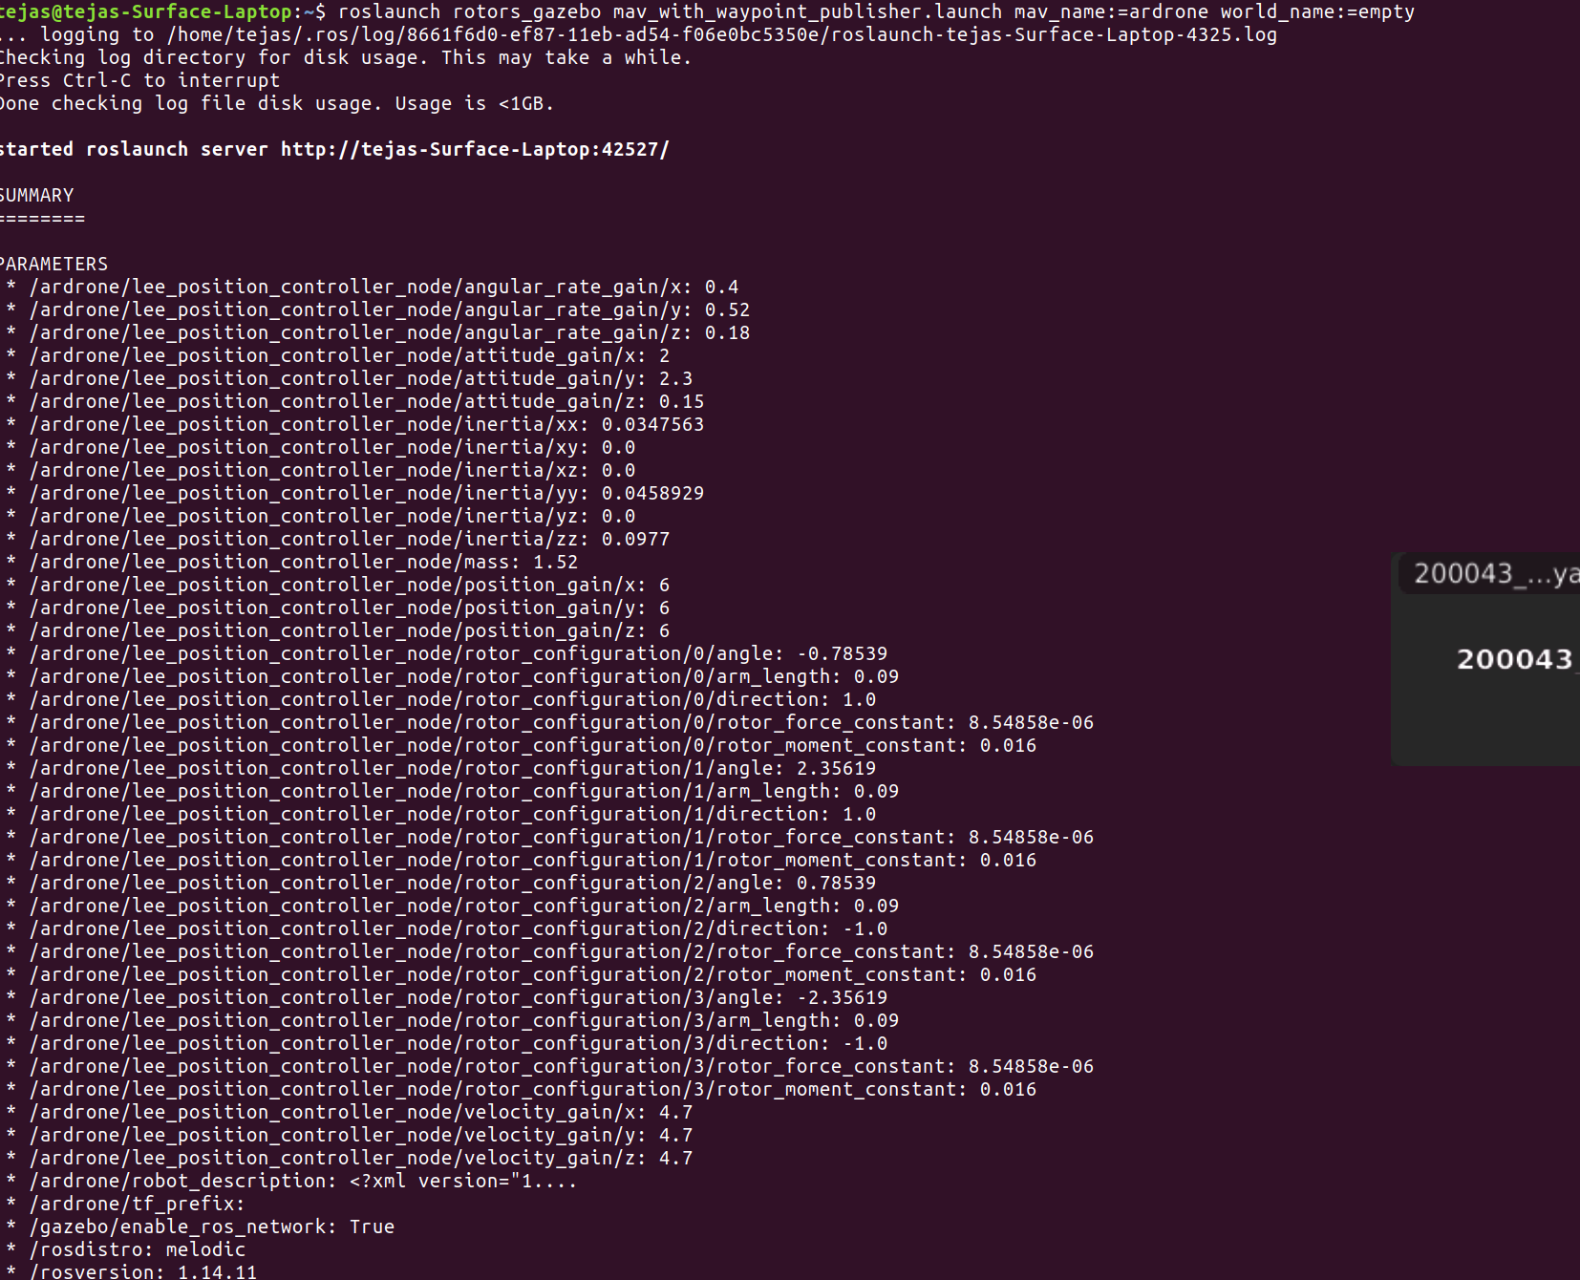
RobotS - UAV gazebo simulator
Creating the package:
Building the package.
To run the setup in gazebo, we run roslaunch, and simultaneously run this.

Slide 31
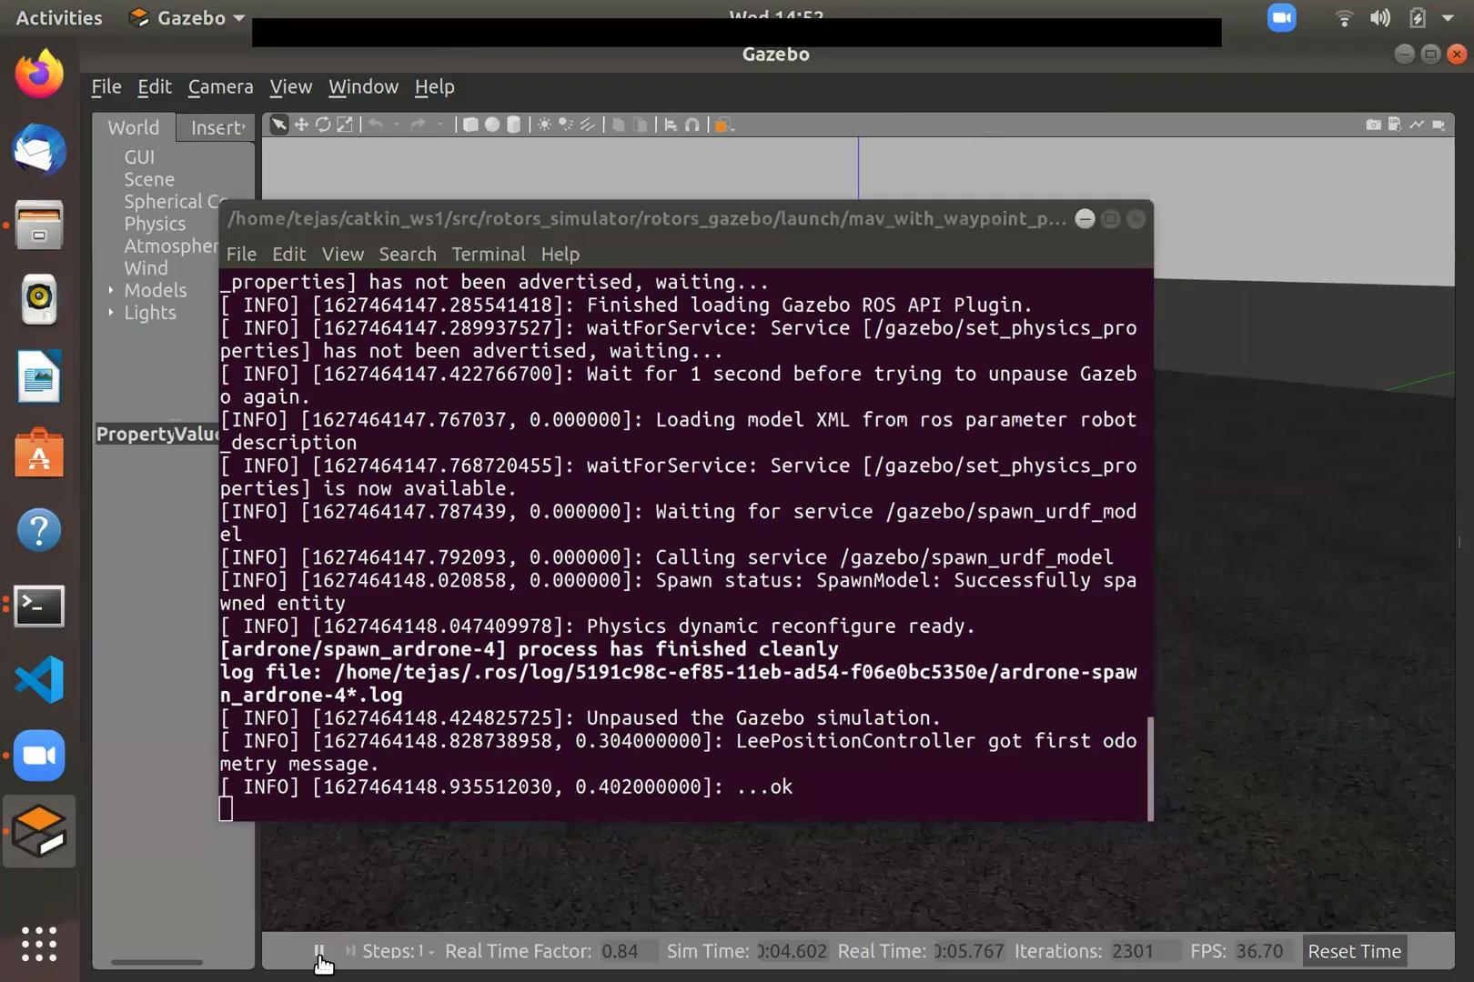
RobotS - UAV gazebo simulator

Slide 32
THANK YOU FOR YOUR TIME!!!!

